Slide 1
COPENHAGEN OPTIMIZATION
Case for 02582

Slide 2




Introduction
We have a consultancy team and development team.
Our consultancy team consists primarily of engineers with expertise in data analysis and operational research.
Our development team has broad experience and many of our developers have an educational background within mathematics and data science.
Who we are
Copenhagen Optimization is a software and consultancy company specialized in airport operations
Founded in 2014
HQ in Copenhagen, Denmark
21 FTEs
Emilie Knutz Senior Consultant
MSc in Engineering from DTU, 2017 – Mathematical Modelling and Computation specialized in data analysis and operations research
Worked at Copenhagen Optimization since graduation
Notes:
Consultancy vs. Software
Software: Startede med excel algorithms, when airports wanted to buy it we could see the gap in the market.
Airport understanding core in our business

Slide 3









































About Copenhagen Optimization
What we do
Our footprint
500
Million passengers a year going through our clients!
Consultancy
Software
Capacity planning
Operational optimization
Operational strategy
COVID-19 resumption
BETTER AIRPORT®
Notes:
Company overview
Copenhagen optimization is a software and consultancy company specialized in airport operations; through our software we serve ~500 million passengers (2019) at some of the world’s largest airports
In the summer of 2020 Copenhagen Optimization (CopOpt) has provided KLIA with pro-bono consultancy services within baggage arrival carousel optimization
As part of the service above, we have demonstrated how our product Better Baggage (part of the suite Better Airport®)

Slide 4
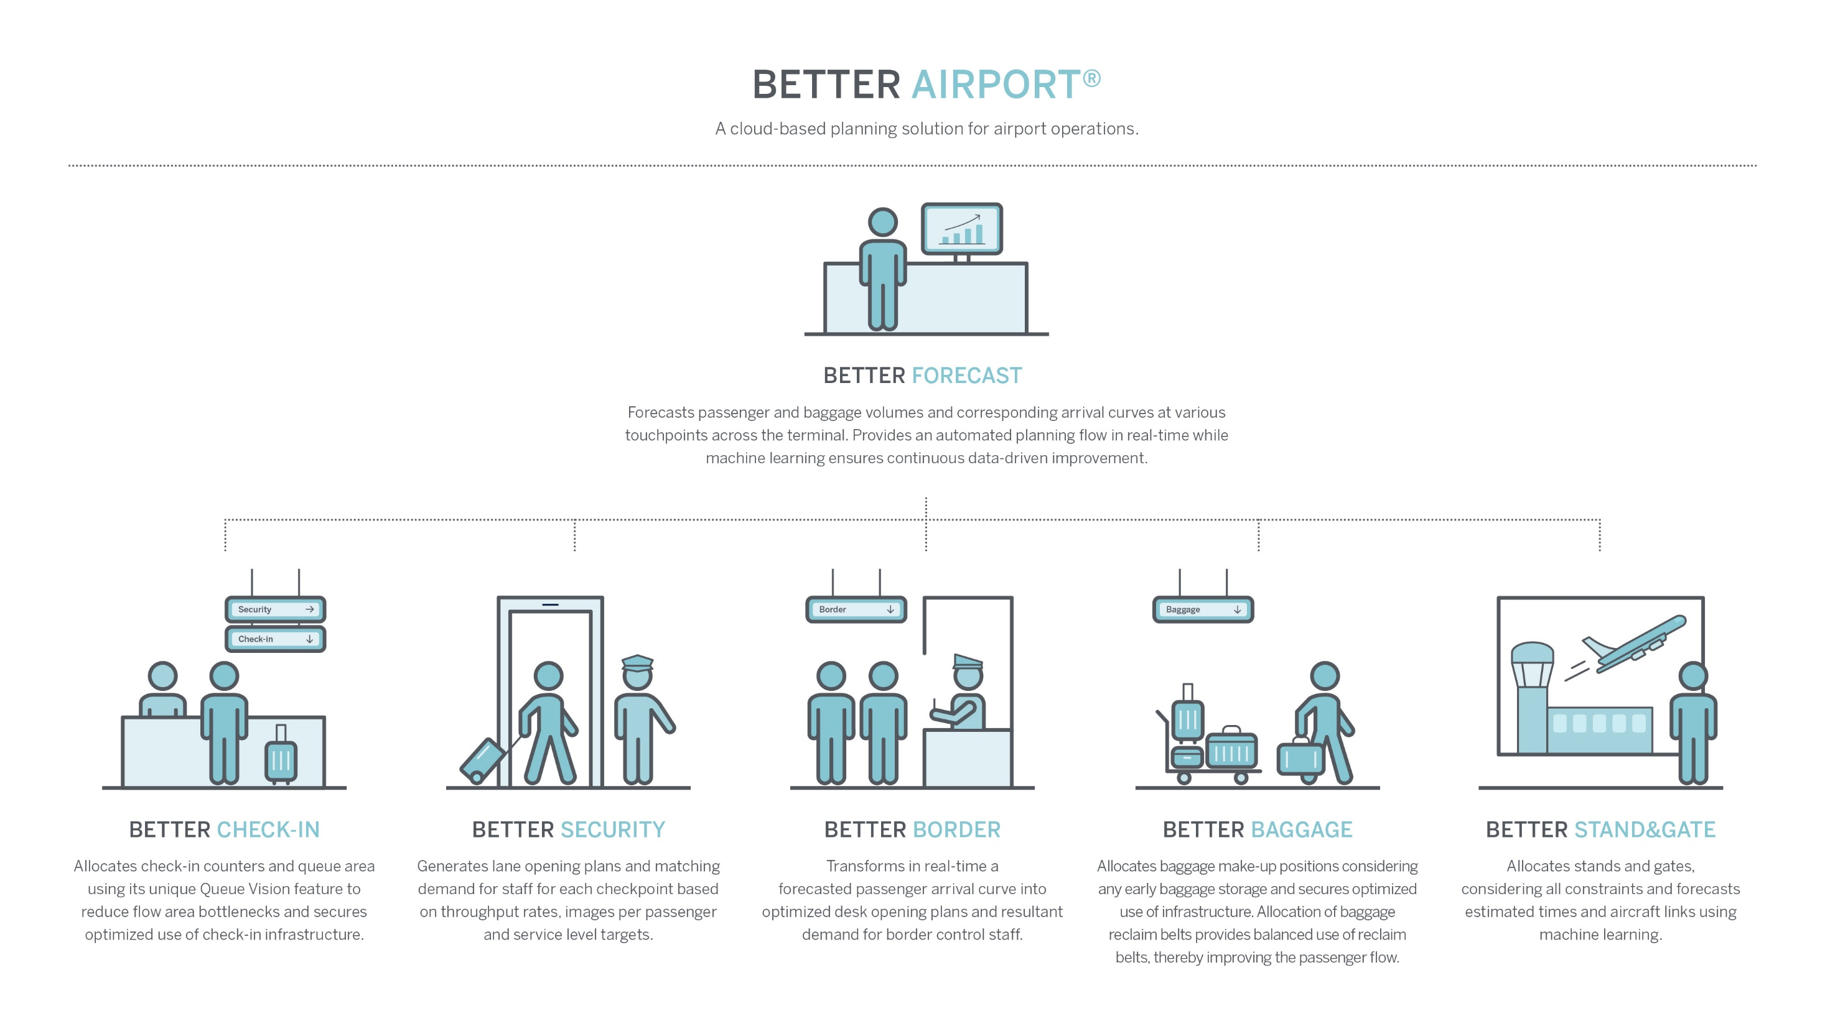
Notes:
Overview of our software Better Airport®
We offer 6 products, which can be bought and implemented independently
Better Forecast communicates with each of the other 5 products
Each product targets a key operational area of airports, and is aimed at optimizing use of infrastructure and staff while delivering service to passengers according to airport targets

Slide 5


High accuracy passenger forecasts are the foundation of optimized airport operations
Passenger Forecasting Case
Input: Flight information
Forecast: Load factor (numbers of passengers divided by seat capacity)
Input flight information:
Future flight schedule for March
Flight schedules with realized load factors for the past year
Goal of the forecast:
We want to predict the load factors for all flights in March.

Slide 6
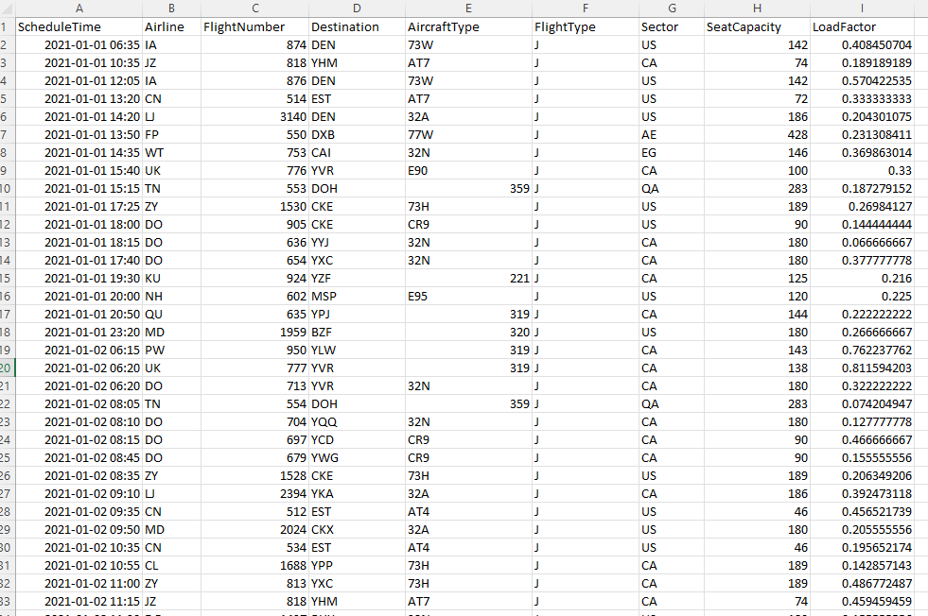
Data Example
Features
ScheduleTime: Date and time of departure for the flight
Airline: Abbreviation code for airline
FlightNumber: ID number of the flight
Destination: Abbreviation code for destination airport
AircraftType: Abbreviation code for aircraft type
FlightType: J (Scheduled flight), C (charter flight)
Sector: Country code for destination
Seat Capacity: Number of seats on the flights
Load Factor: Share of seats occupied by passengers on the flight

Slide 7
Preprocessing steps: Training and test datasets
Training and test datasets
Test period
Training set this year
Test set
Training set last year
Training the model
What data is relevant to include in the training set?
Only recent data?
Same time of the year during last year?
How could COVID19 have impacted the passenger numbers?

Slide 8




Preprocessing: Features
Feature category
Ideas for features
Flight features
Airline
Flight Number
Aircraft Type
Flight Type
Destination
Sector
Seat capacity
Time features
Weekday
Week number
Month
Day of Month
Year
Hour
Minute
Training the model
What features are relevant to include?
Calendar features
Days from new years day
Days from Easter
… Days from relevant holidays
Days that are outliers
Other relevant features?
Any relevant features for forecasting time series?
Are there any tendencies in the load factors, for example per airline, weekday, destination, etc.?

Slide 9
Data, Hand-in, and Deadline
Data:
The realized data is from 2021-01-01 to 2022-02-28 (the full realized schedule data is sent out at the beginning of March).
The period that the forecast should be generated for is 2022-03-01 to 2022-03-31 (this future schedule data is also sent out at the beginning of March).
Hand-in:
You have the freedom to choose any method to analyze the data and produce a passenger forecast per flight.
The output should be a file “output.txt” containing the future schedule for March and with a column added with the forecasted load factor (ratio of number of passengers per flight to seat capacity).
In addition to this, a small report (maximum 5 pages) with a description of the pre-processing, modelling, and model assessment should be handed in.
There will be a price for the forecast with the overall highest accuracy.
Furthermore, you should state your expected total accuracy, and there is another price for the team that gets closest to their estimated total accuracy.
Deadline:
The deadline for the case is March 21st
The winner will be announced on March 24th

